Slide 1


DFW International Airport
Bonfire Workshop
for Concessionaires
Hosted by the
Procurement Department

Slide 2
Bruce D. Collins
Vice President
Procurement and Materials Management

Slide 3


PMM
Mission | Vision | Beliefs
Our mission is to provide an inclusive, integrated, and respectful Procurement & Material Management solution.
Our Vision is to improve predictability in the customer experience by adding a comprehensive value to the procurement process.

Slide 4

Cone of Silence
Developed to ensure proper and fair evaluation. It is designed to protect the integrity of the proposal process by shielding it from undue influences.
It begins with the RFP advertisement/release and ends with the Board’s selection for RFPs, noting that release of some information is restricted by law.
Potential proposers cannot discuss any aspect of a released solicitation with Airport personnel with the exception of the contract administrator listed in the RFP.
All documentation and correspondence must be submitted via Bonfire and paper copies.
Proposals must be submitted by the deadline and time stated.

Slide 5

What is Bonfire?
Once registered, Concessionaires can view and download proposals from any organization’s Bonfire Portal.
Concessionaires can submit proposals from the comfort of their office or home.
No more rushing to AHQ through traffic!
No more shipping costs to deliver multiple proposals!
An eProcurement platform used by the public sector to streamline the solicitation process.

Slide 6

Overview-Benefits
DFW Airport implemented an electronic solicitation portal known as Bonfire. The portal will:
  Expedite the solicitation process, reducing timelines and increasing competitive bids;
  Provide a convenient solicitation process with full customer support;
  Automate bid tabulations and evaluations, eliminating potential for error; and
  Provide a secure process with compliance and accessibility features.
The new portal is available online 24/7 from most electronic devices.
Bonfire may sound familiar as several Texas municipalities and agencies are currently using Bonfire Portal as well.
  City of Frisco
  Denton County
  City of Dallas

Slide 7

Addressing DFW’s Key Results
Bonfire supports the Airport’s goal to:
Maximize Business Performance
Drive Operational Excellence
Strengthen Community Impact

Slide 8
THANK YOU

Slide 9
Latrece Crownover
Sr. Contract Administrator

Slide 10
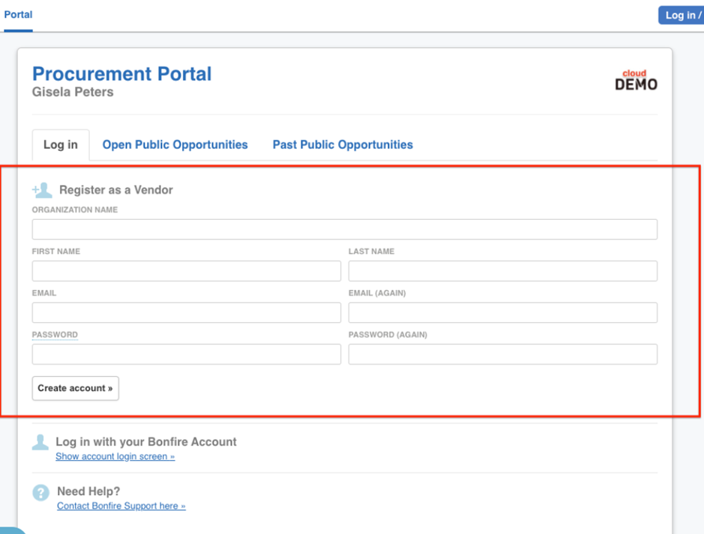
Vendor Registration
Registration for DFW’s Bonfire Portal is quick, easy and free.
Once registered, you will be able to create submissions for the Open Public Opportunities.
In addition to general organizational information, you will be able to:
  Select commodity codes
  Upload documents (i.e. insurance or MWBE certifications)

Slide 11
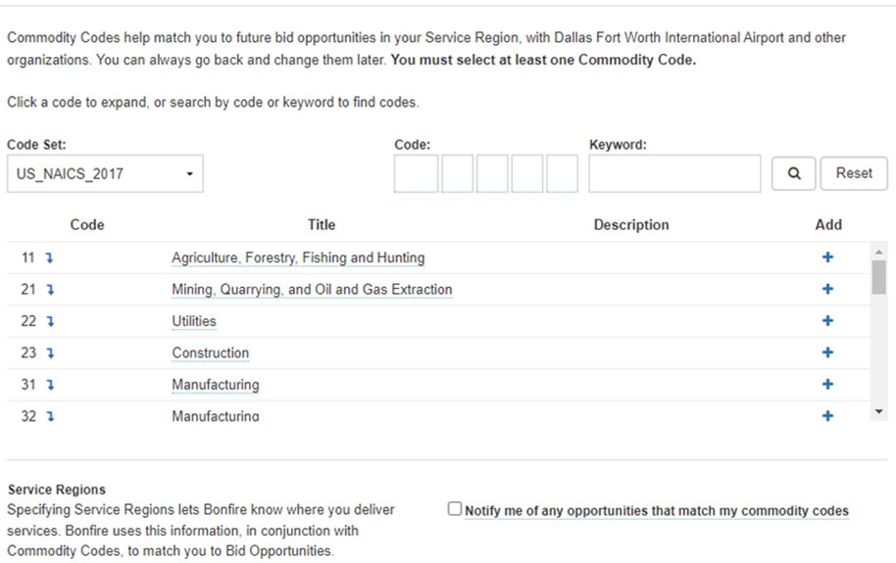
COMMODITY CODES
Include all commodity codes that align with your services.
Select the box that reads Notify me of any opportunities that match my commodity codes.
You can return to this page and add or remove any commodity codes :
Settings → Global Vendor Record → Commodity Codes/Opportunity Matching

Slide 12
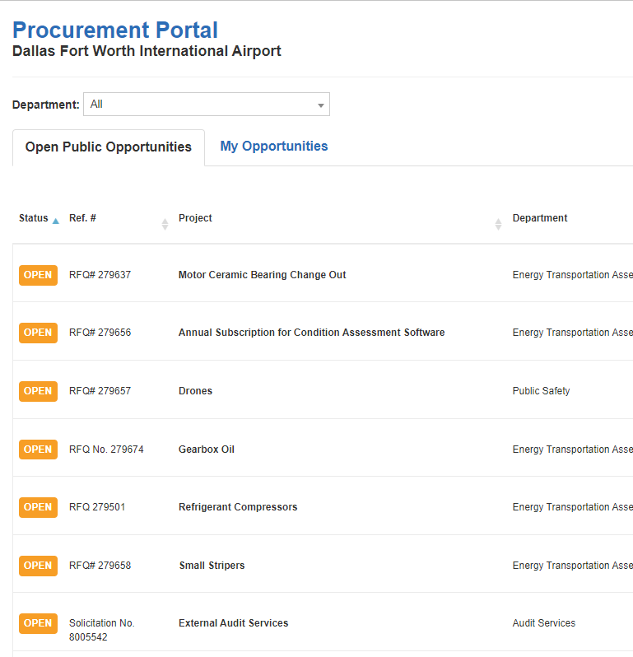
Navigating the Procurement Portal
The DFW Procurement Portal is public. Anyone can view the listing of Open and Past Public Opportunities.
The Procurement Portal will provide an overview of the Status, Solicitation Number, Project Name, Relevant Department, Close Date, and the number of days left to submit a bid/proposal.
In order to download documents or create a submission you must be logged-in to the Procurement Portal and select View Opportunity.

Slide 13
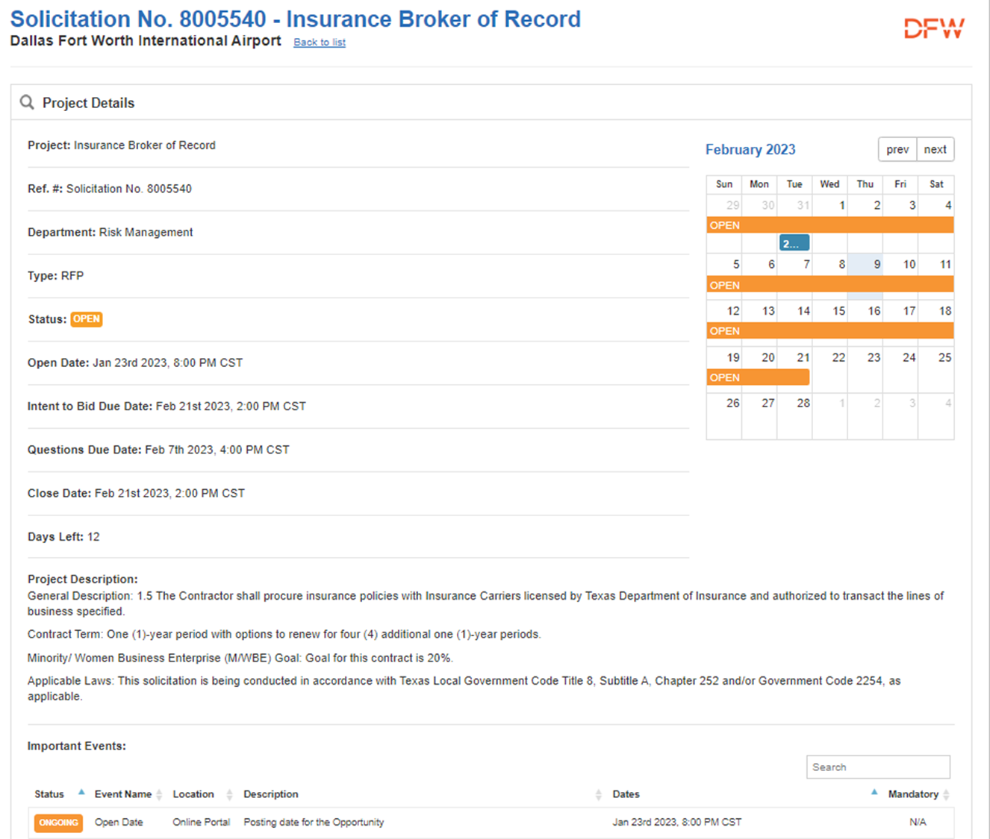
Viewing Opportunities
The Project Details page includes relevant information to the solicitation, including:
  Type of Solicitation
  Status
  Important Events
  All Supporting Documentation
  Decisions/Package Options
  Requested Information
  Messages/Public Notices
    Keep a look out for public notices as they will alert you to new Addendums or Requested Information

Slide 14
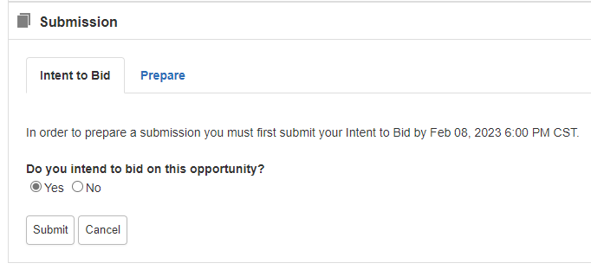
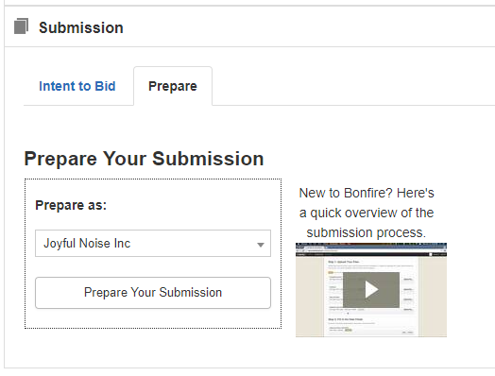
Beginning Your Submission
  Download and review all supporting documentation.
  If you intend to Bid, you must select YES at the bottom of this screen.
  Then select Prepare Your Submission.
This platform will automatically save all information, uploaded documentation, and selections.

Slide 15
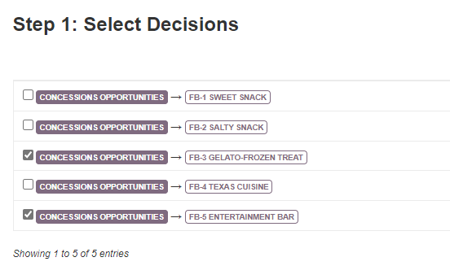
Creating Your Submission
Select your Decision or Concessions Opportunity Package(s).
This will allow you to only submit documentation that is pertinent to the packages you would like to bid on.

Slide 16
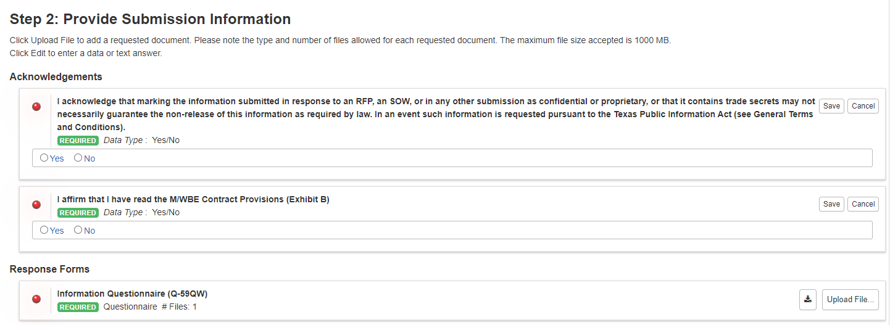
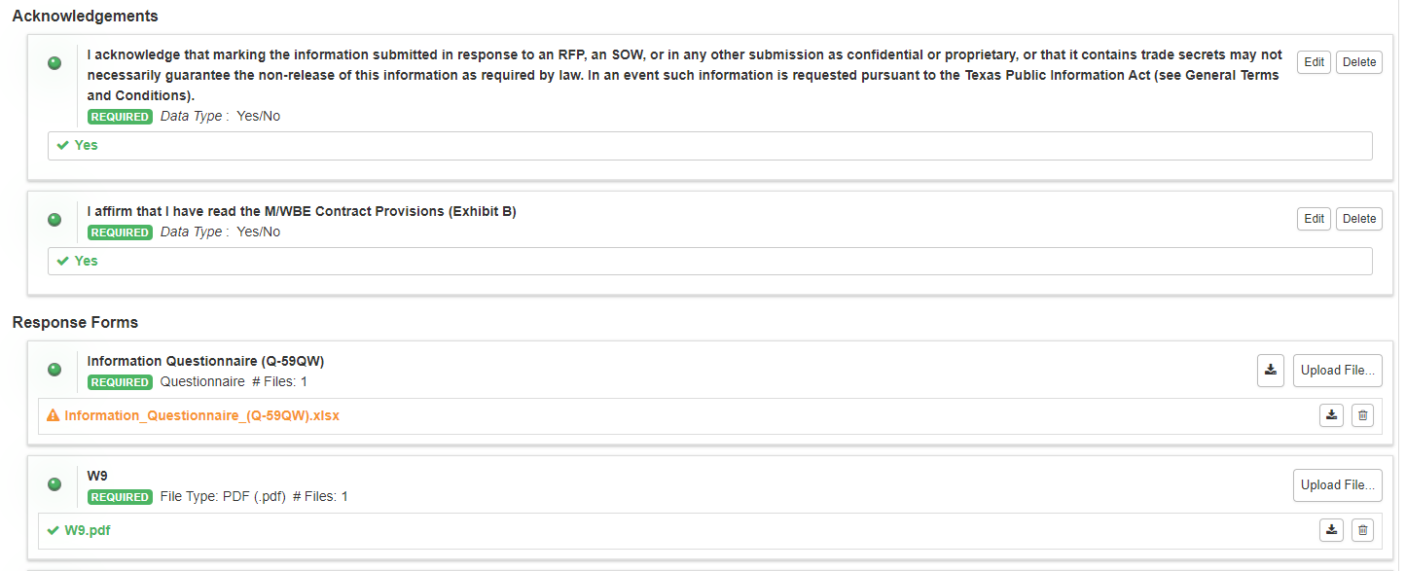
Creating Your Submission
Provide your submission information by addressing the acknowledgements and uploading the required documentation.
All items marked REQUIRED must be uploaded or Bonfire will NOT accept your proposal.
Make sure all items have a green bullet.

Slide 17
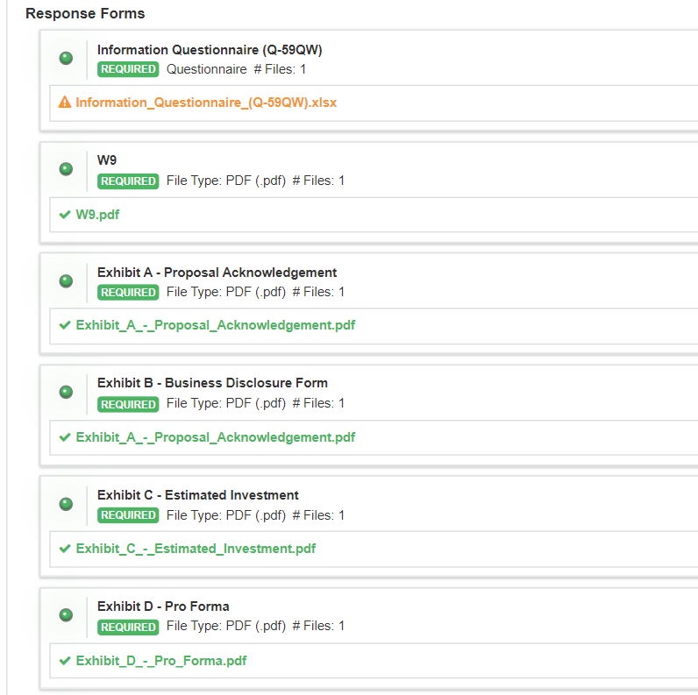
Finalizing Your Submission
Bonfire will not verify the contents of your documents, only you can do that.
Make sure you title the documents appropriately on your computer, then upload the corresponding documents to each field.
Confirm your documents are correct before you submit your proposal.

Slide 18
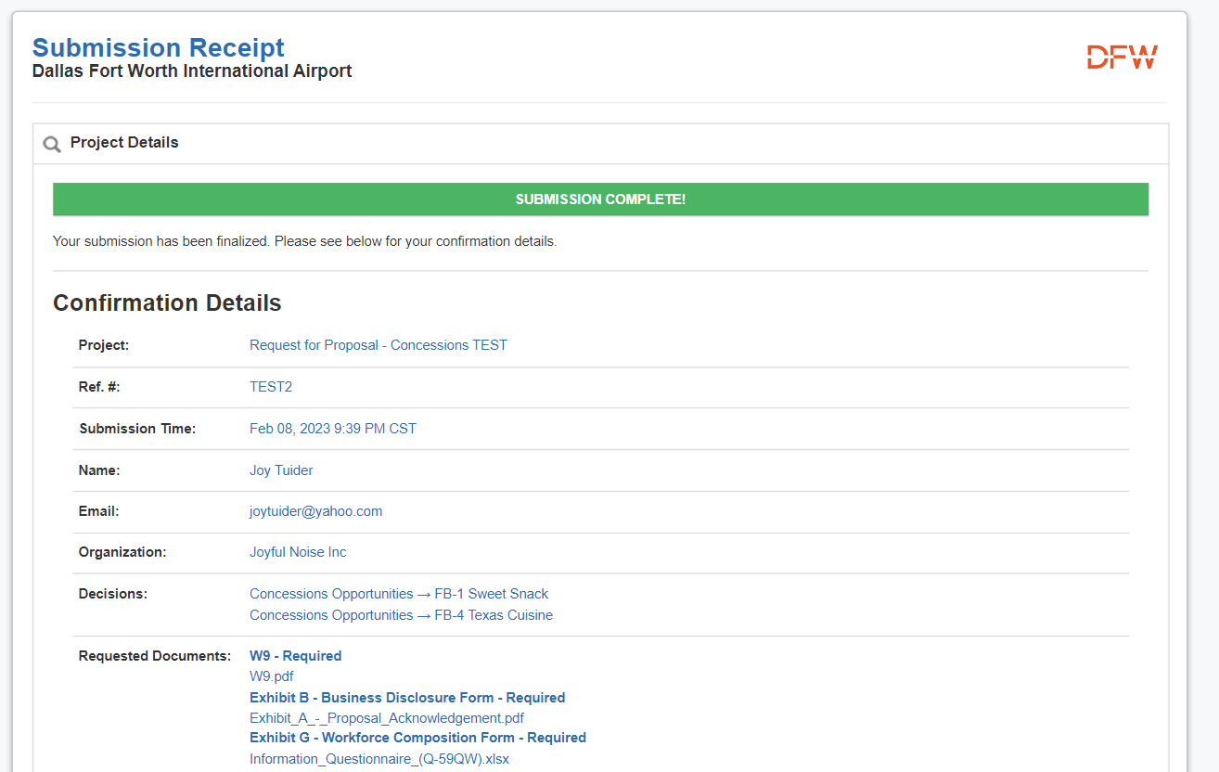
Check your documents ONE LAST TIME
Correct
Incorrect
Incorrect

Slide 19
Key Takeaways
Check your documents as Bonfire will not confirm the content
Respond to what the RFP requests and avoid placing limitations or conditions.
If you have an issue uploading a document, ensure the document is COMPLETE, then re-upload.
You can change/update your submission only until the closing/due date.
DO NOT WAIT until the last minute to prepare a proposal. Understand that teaming efforts, subcontracting, and preparation takes quality time.
Deposit Checks must be provided to the Contract Administrator for each location prior to the proposal date and time. Checks will be returned after Airport Board approval of awardees.

Slide 20


Slide 21
Contact Information
Latrece Crownover
Miriam Seymour
Senior Contract Administrator
Contracts Manager
  972-973-0995
  lcrownover@dfwairport.com
  972-973-5631
  mseymour@dfwairport.com

Slide 22

Thank You
Customer Support Website and contact:
  https://vendorsupport.gobonfire.com/hc/en-us
support@gobonfire.com

