Slide 1



NCTRCA
North Central Texas Regional Certification Agency

Slide 2


Angela Alexander
Executive Director

Slide 3





35 YEARS ON A MISSION
About
The
NCTRCA Organization
The North Central Texas Regional Certification Agency (NCTRCA)
was established with a mission to enhance economic opportunities for historically underutilized businesses, NCTRCA certifies minority, women-owned, and disadvantaged enterprises, providing them with access to a wide range of contracting opportunities with government agencies and private sector organizations.
Through our certification programs, advocacy efforts, and collaborative partnerships, we strive to build a vibrant and diverse business community that drives innovation, economic growth, and prosperity for all stakeholders. Join us in our mission to create a more inclusive and equitable marketplace where every business has the opportunity to succeed and contribute to the region's prosperity

Slide 4





Empowering Businesses Through Certification
Our Value Proposition
CERTIFICATION TEAM
SEAMLESS INTEGRATION
OUTREACH & EDUCATION
Our dedicated certification officers offer free consultation services to guide and support every applicant through the certification process. We understand the importance of certification in accessing contracting opportunities, and our team is committed to ensuring a smooth and successful certification journey for all applicants.
NCTRCA is proud to be fully integrated with the B2GNow system, a robust platform that facilitates seamless communication and information sharing. This integration enables member entities to access real-time data and insights on over 4000 certified firms, streamlining procurement processes and promoting transparency.
NCTRCA actively collaborates with member entities to organize workshops and events aimed at fostering education, networking, and professional development opportunities. These partnerships are integral to our mission of promoting diversity, equity, and inclusion in procurement practices and supporting the growth and success of certified businesses in the region.

Slide 5

Our
Services
DBE CERTIFICATIONS
MBE CERTIFICATIONS
Disadvantaged Business Enterprise Certification
Minority-Owned Business Enterprise Certification
WBE CERTIFICATIONS
SBE CERTIFICATIONS
Women- Owned Business Enterprise Certification
Small Business Enterprise Certification
ACDBE CERTIFICATIONS
SBEC CERTIFICATIONS
Airport Concessionaire Disadvantage Business Enterprise Certification
Small Business Enterprise Concession Certification

Slide 6

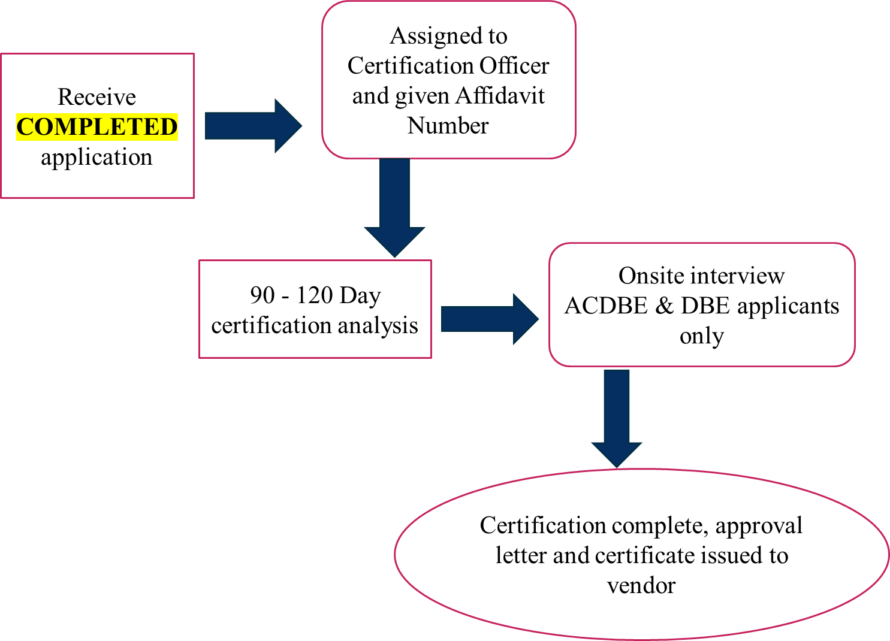
Certification Process

Slide 7
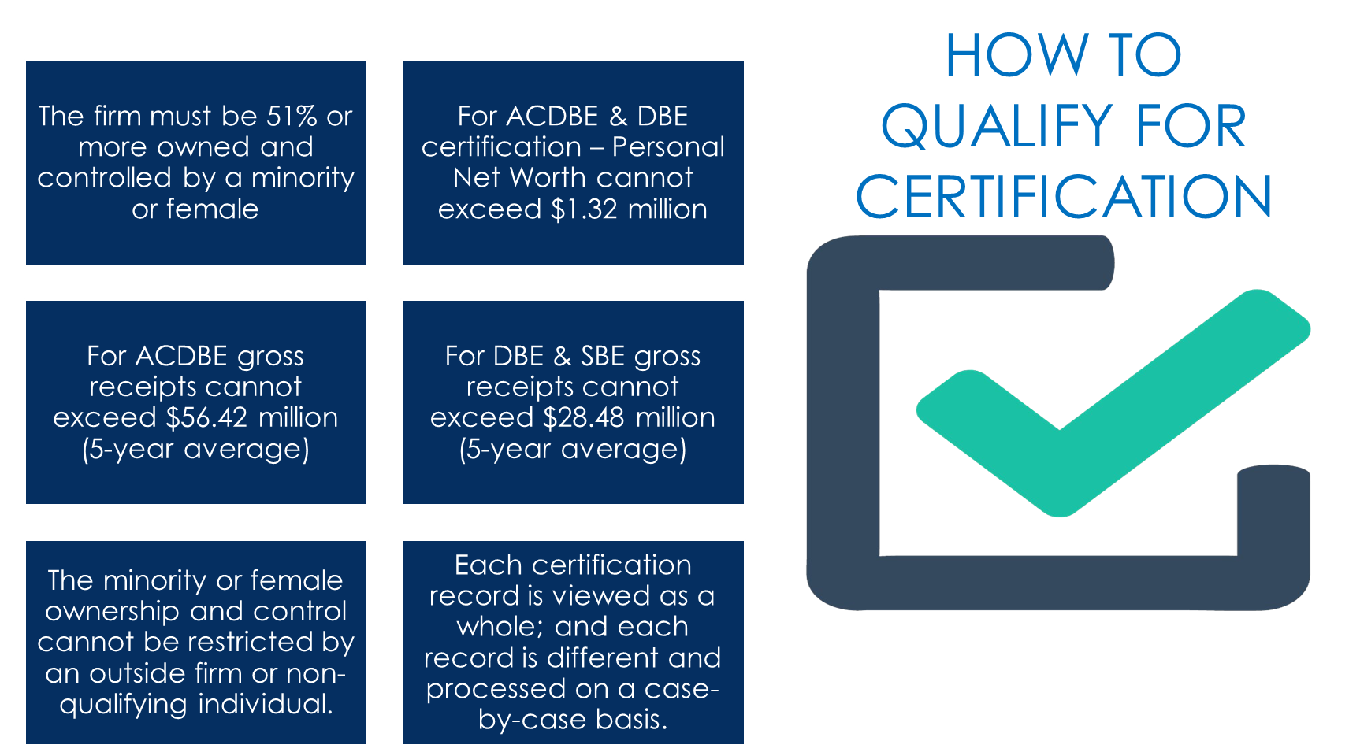

Slide 8
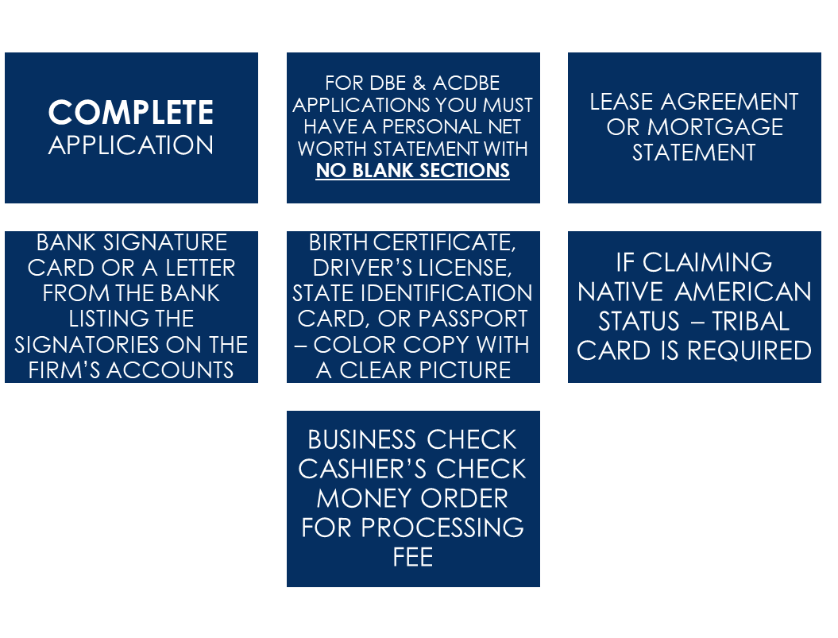
IMPORTANT DOCUMENTS

Slide 9
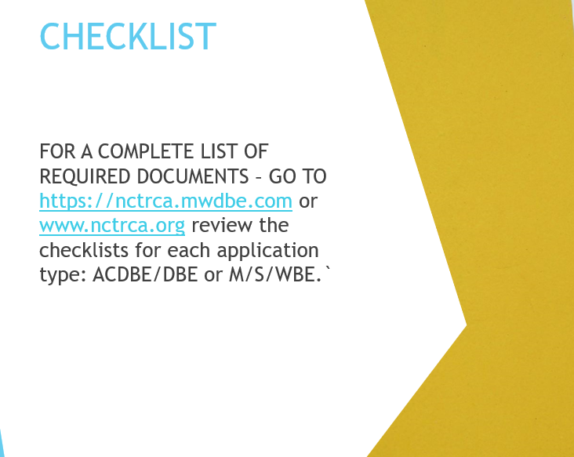
ACDBE and DBE Applications
There is no charge for ACDBE or DBE application processing.
This is a federal program and there are no fees associated with it.

Slide 10
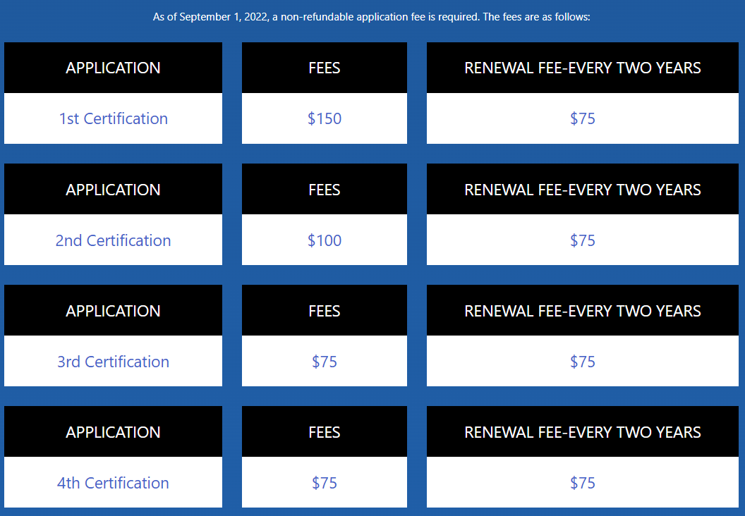
NCTRCA
Application
FEEs
*Out of Jurisdiction (NCTRCA’s 16 Counties) - $250

Slide 11
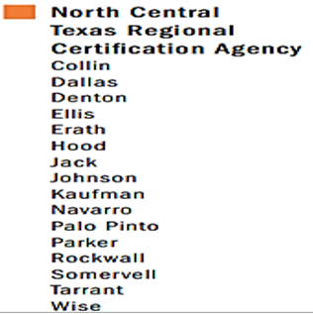
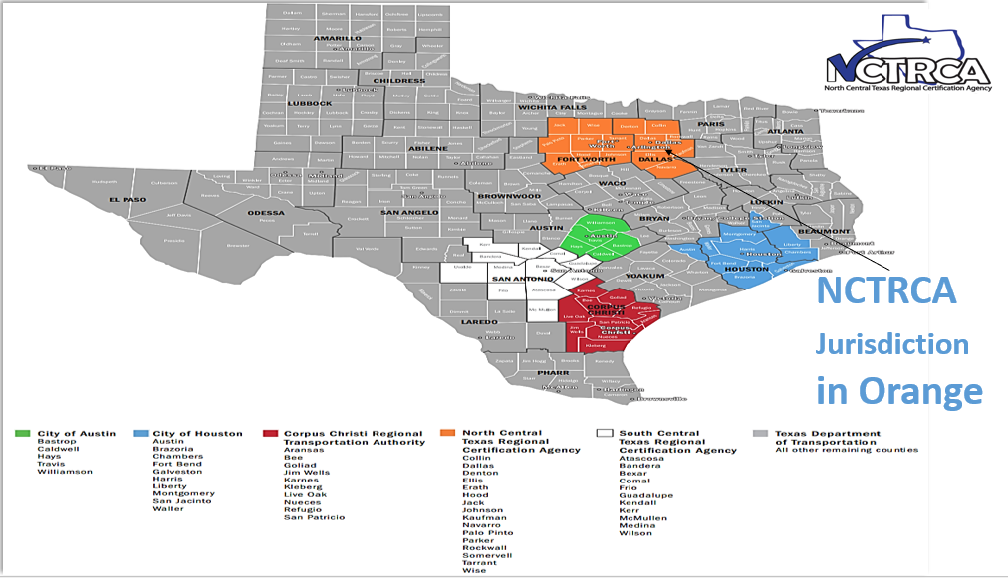

Texas United Certification Program (TUCP) Jurisdictional Map

Slide 12
22 Public and governmental member Entities
City of Arlington
City of Cedar Hill
City of Dallas
City of Desoto
City of Fort Worth
City of Irving
City of Lancaster
City of Mesquite
City of Grand Prairie
Dallas Area Rapid Transit (DART)
Parkland Hospital
Dallas County
Dallas College (DC)
D/FW Airport
Dallas Independent School District (DISD)
Fort Worth Independent School District (FWISD)
Trinity Metro Transit Authority
North Texas Tollway Authority (NTTA)
Tarrant County
Tarrant County College District (TCCD)
Tarrant Regional Water District (TRWD)
Austin Industries (Associate Member)

Slide 13

Meet NCTRCA Member Entities
ENTER NAME
ENTER NAME
ENTER NAME
ENTER NAME
The North Central Texas Regional Certification Agency boasts a robust membership of 22 entities, enhancing its strength and diversity in regional certification efforts.
NCTRCA’s Database of over 4000 Certified Vendors

Slide 14

THANK
YOU
NORTH CENTRAL TEXAS REGIONAL CERTIFICATION AGENCY
2261 BROOKHOLLOW PLAZA SUITE 300
ARLINGTON, TX 76006
APPLY ONLINE: https://nctrca.mwdbe.com
For more information: www.nctrca.org

